Slide 1
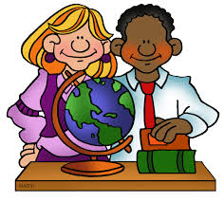
¡ustedes son maestros!
Group activity
Presented in front of class
Teach a mini lesson about the subject you are given
Create notes for the class to take
Create a mini assignment that the class will do

