Slide 1
Vida Saludable (Healthy Life) Unit 3 continued

Slide 2
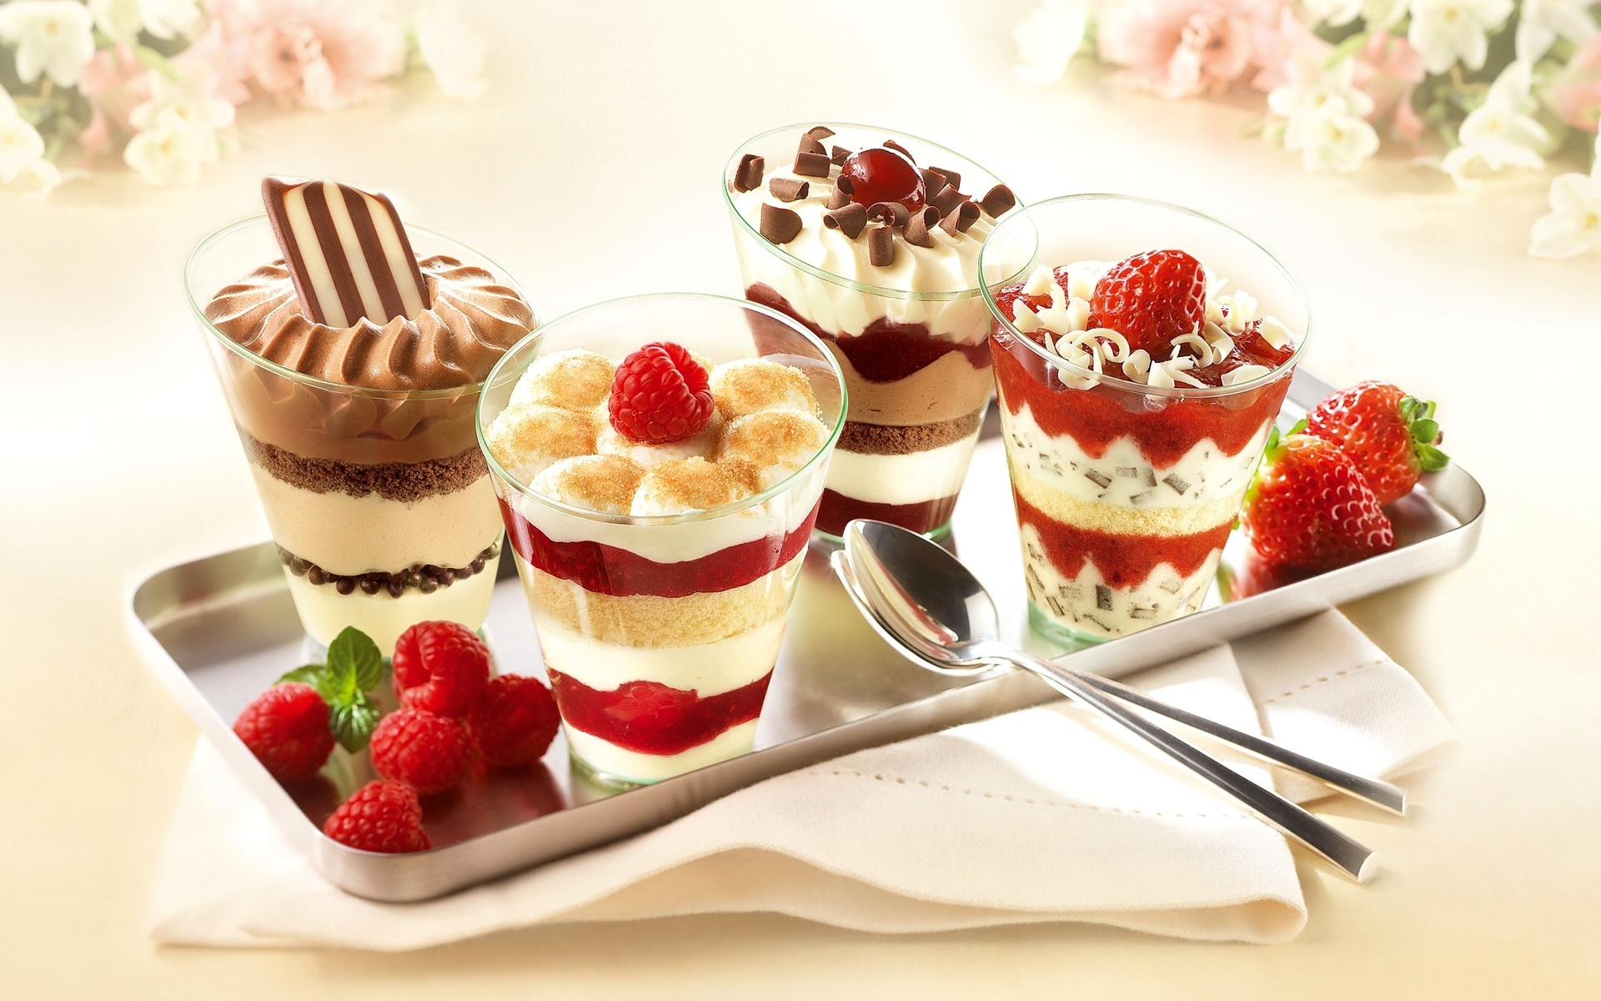
El postre
The dessert

Slide 3
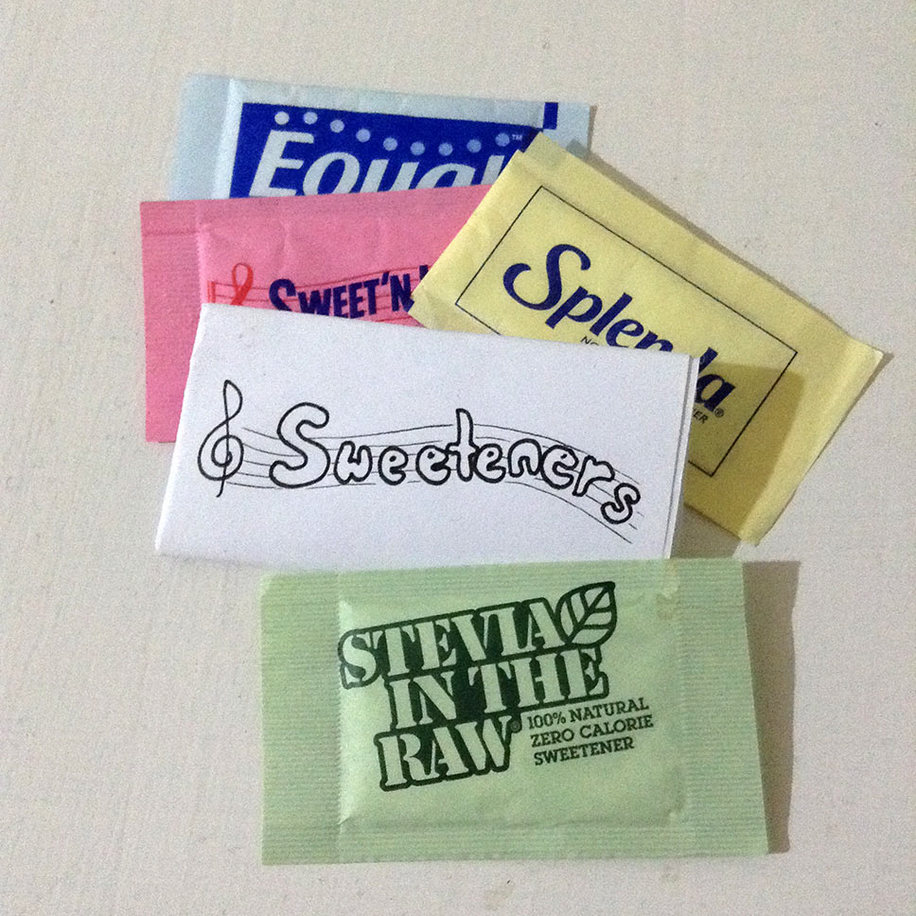
Dulce Sweet

Slide 4
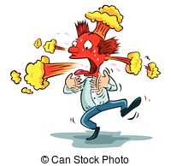
Picante
Spicy

Slide 5
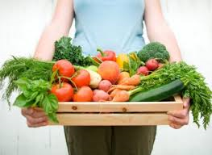
Fresco/a
Fresh

Slide 6
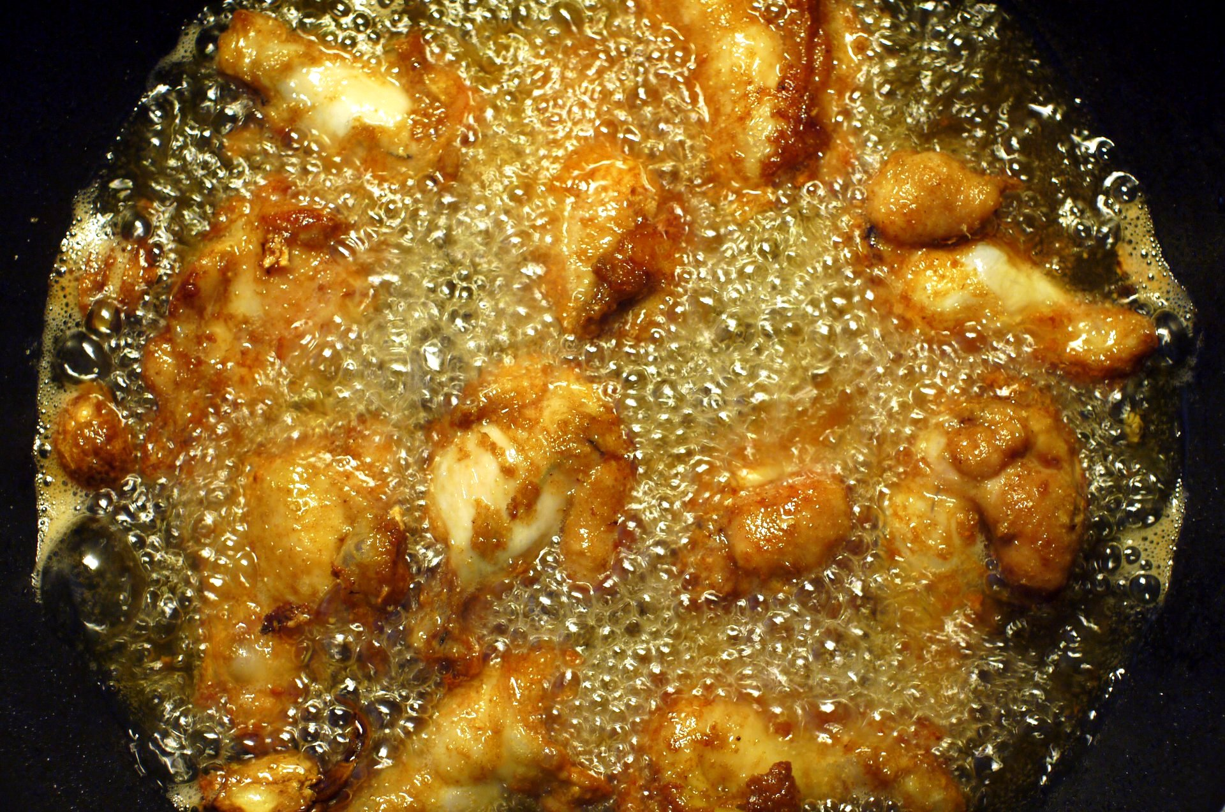
Frito/a
Fried

Slide 7
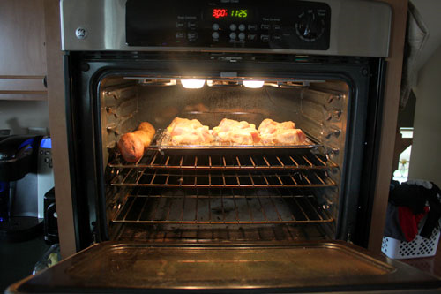
Al horno
Baked

Slide 8
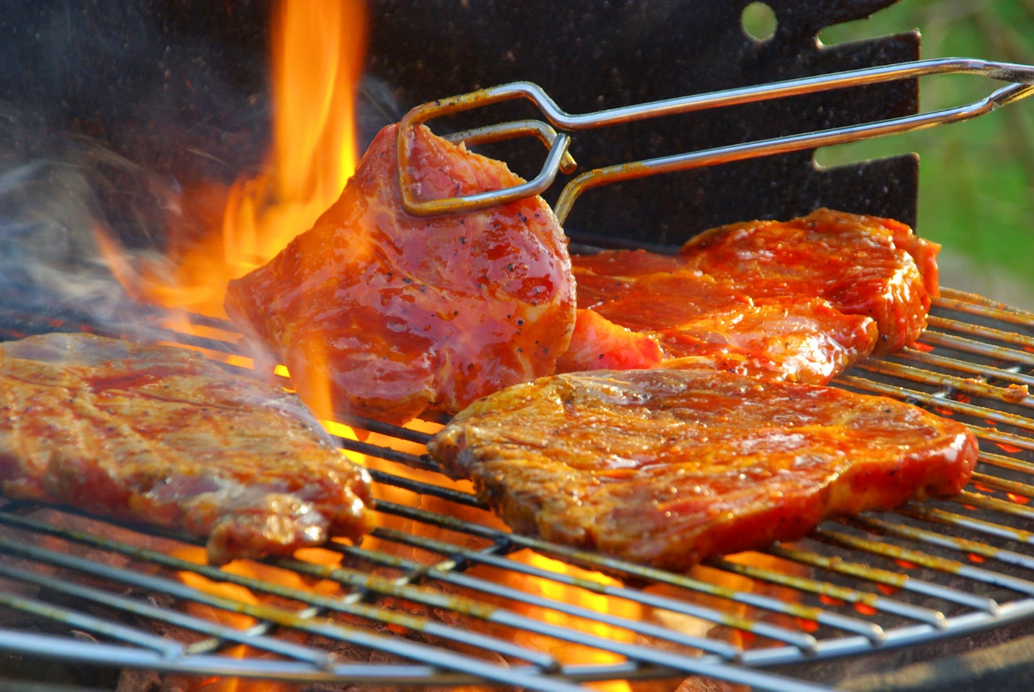
A la parilla
Grilled

Slide 9
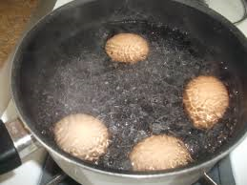
Hervido/a
Boiled

Slide 10
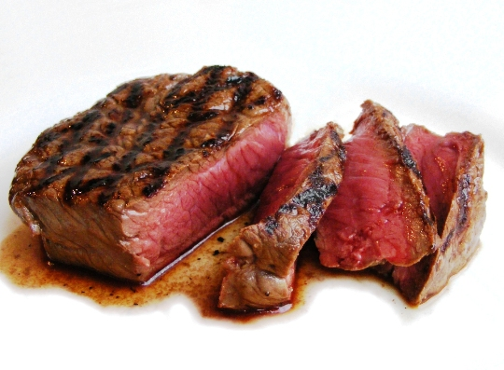
El bistéc
The steak

Slide 11
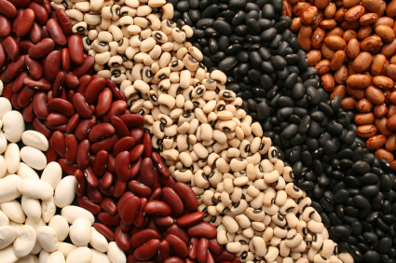
Los frijoles
The beans

Slide 12
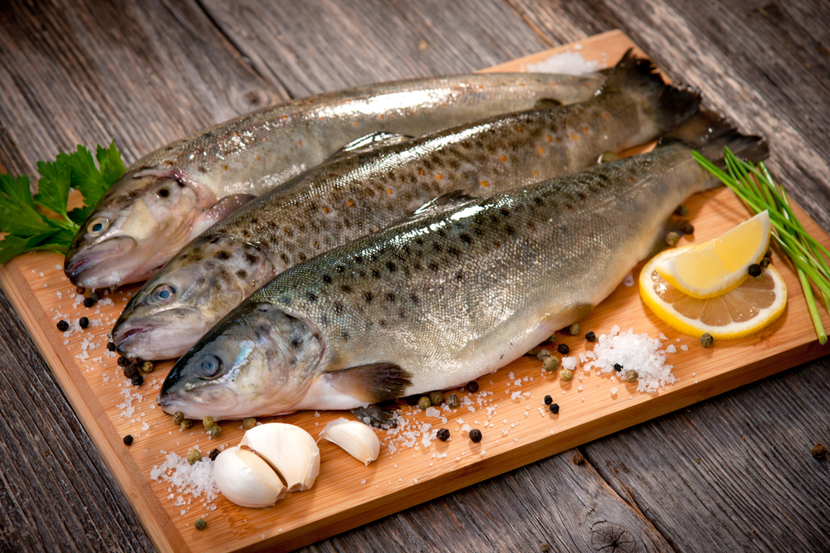
El pescado
The fish

Slide 13
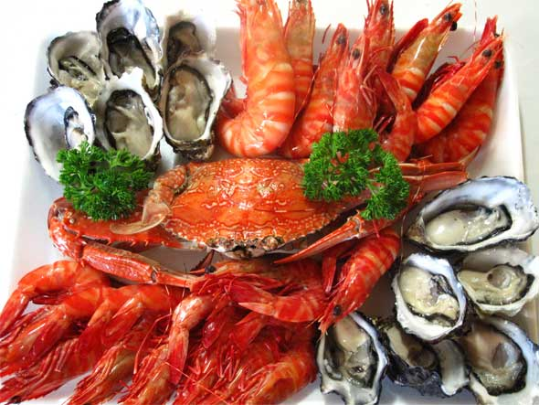
Los mariscos
The seafood

Slide 14
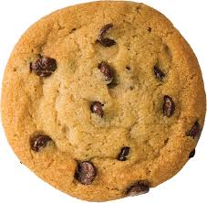
La galleta
The cookie

Slide 15
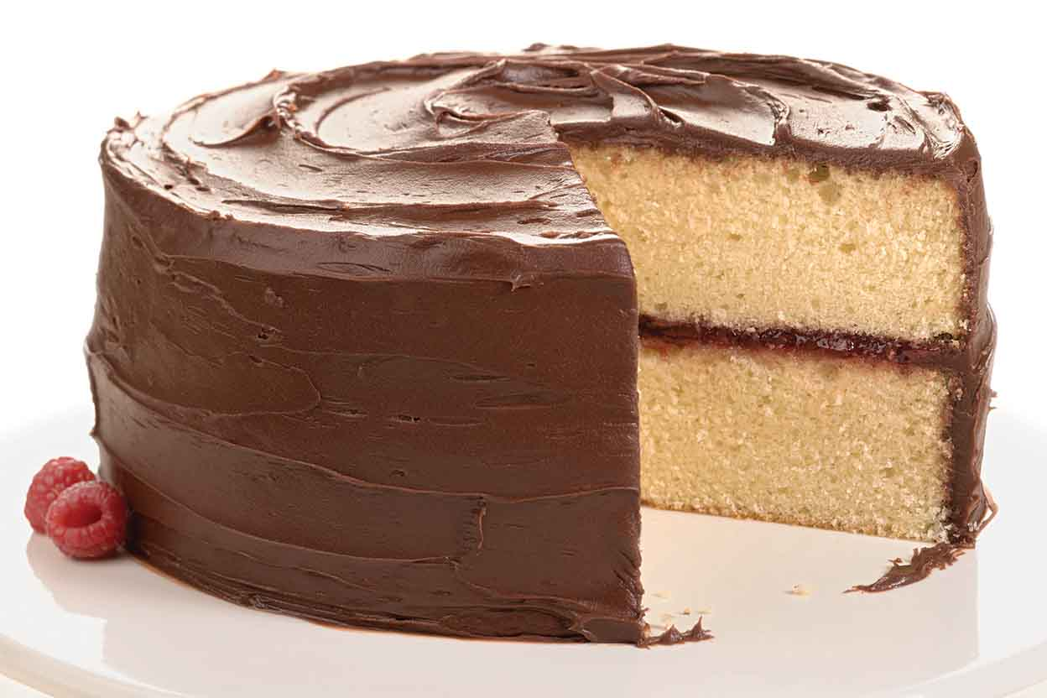
El pastel
The cake

Slide 16
Es bueno/a para ti.
It’s good for you.

Slide 17
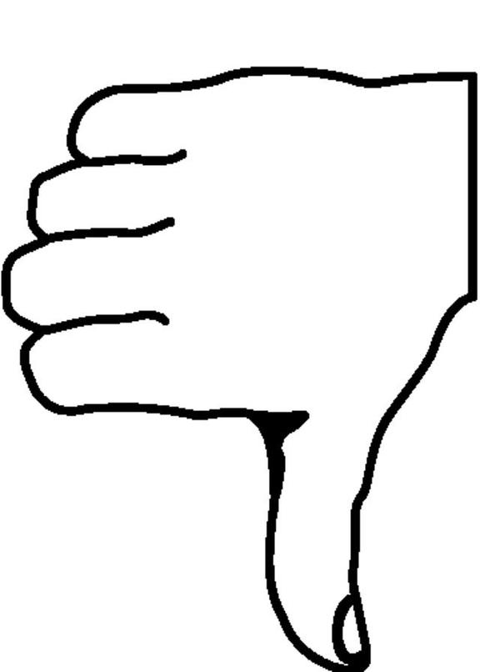
Es malo/a para ti.
It’s bad for you.

Slide 18
Deber- should
Yo Tú Él/Ella/Usted Nosotros/as Vosotros/as Ellos/Ellas/Ustedes | Debo Debes Debe Debemos Debéis Deben

Slide 19
Deber- should
You use deber to say when someone should do something.
Deber + infinitive
Ejemplos:
Debemos comer comida fresca. (We should eat fresh food.)
No debe comer comida dulce. (He/She should not eat sweet food.)

Slide 20
¿Es Bueno o malo para ti?
Make a list of foods that are good for you and foods that are bad for you.
Es bueno para ti | Es malo para ti

Slide 21
¿Qué debes comer?
Using the lists you made, write two sentences saying what you should and should not eat.
Debes comer…
No debes comer…

