Slide 1
White Board
8/11/2015
Bellwork: Name a Spanish-speaking country you would like to visit and why.
Guiding Question: Why is it important to communicate in a different language?
Objective: I can explain the “Path to Proficiency”.
Activity: Proficiency, Spanish-speaking countries
Homework: Return Syllabus Acknowledgement form.
SPI’s: 1.2A, 2.2B

Slide 2
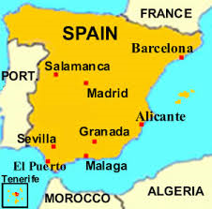

Slide 3
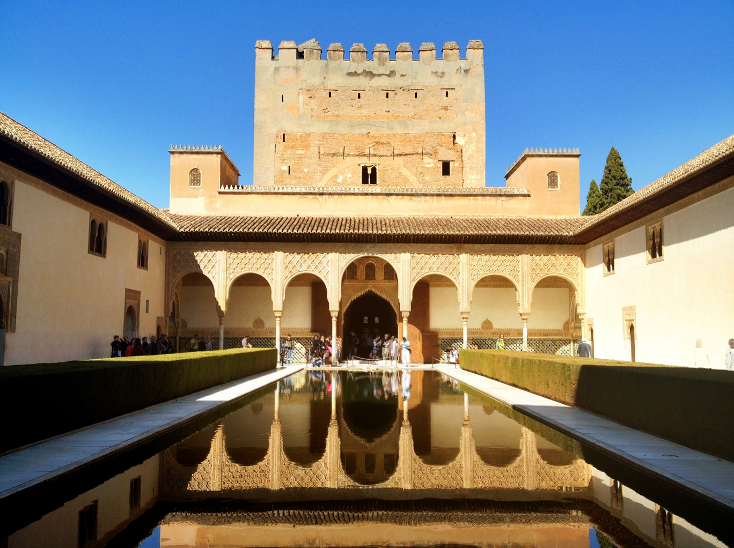
La Alhambra

Slide 4
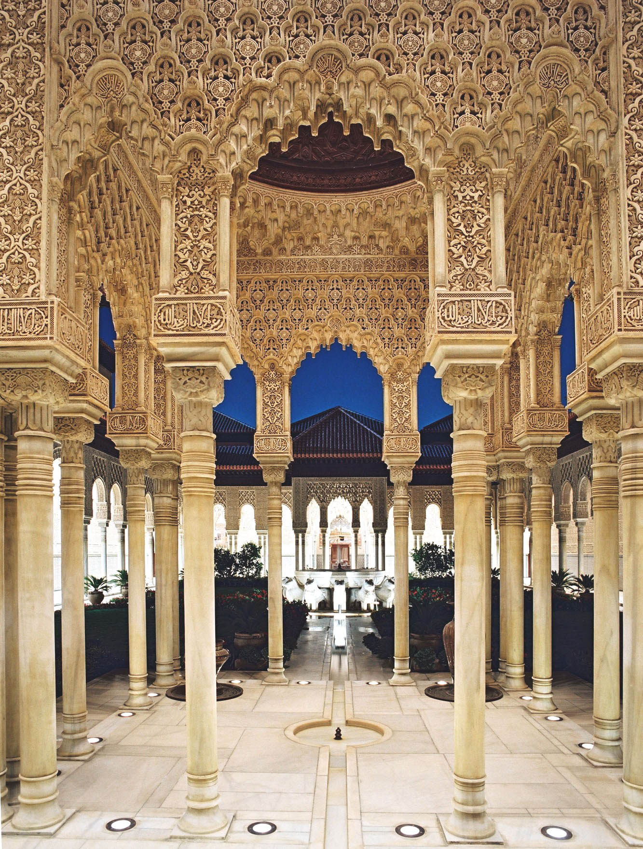
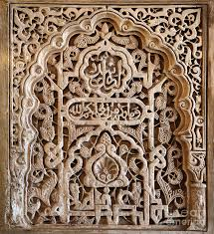

Slide 5
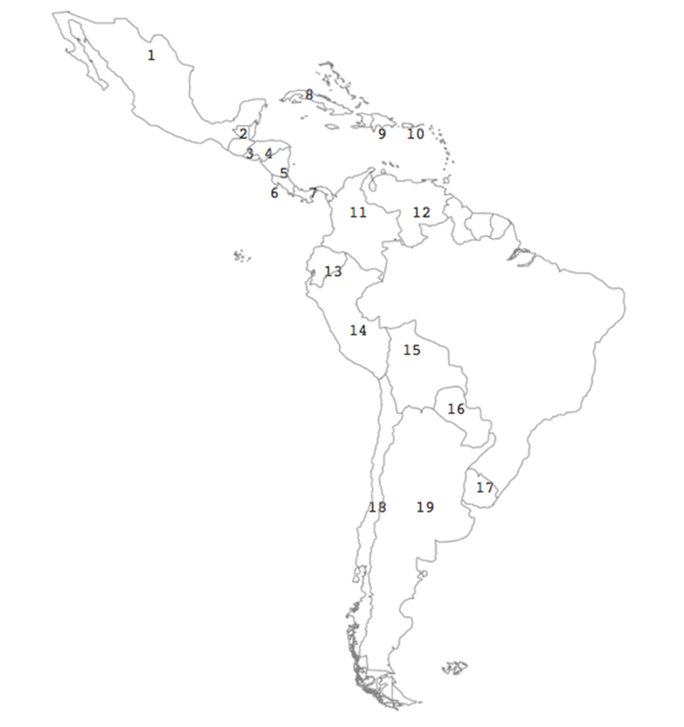
Argentina
Bolivia
Chile
Colombia
Costa Rica
Cuba
Ecuador
El Salvador
Guatemala
Honduras
México
Nicaragua
Panamá
Paraguay
Perú
Puerto Rico
República Dominicana
Uruguay
Venezuela

Slide 6
México
Guatemala
El Salvador
Honduras
Nicaragua
Costa Rica
Panamá
Cuba
República Dominicana
Puerto Rico
Colombia
Venezuela
Ecuador
Peru
Bolivia
Paraguay
Uruguay
Chile
Argentina

