Slide 1
Hoy es el dieciocho de agosto de dos mil quince.
White Board
El calentamiento: Name 3 different ways to say goodbye in Spanish.
Pregunta influyente: What do I already know in Spanish?
Objectivo: The Student will demonstrate current abilities through pre-assessment.
Actividades: pre-assessment, writing pre-assessment.
SPI’s: 1.1 A, B
Tarea: Bring colored pencils, crayons, or markers to class tomorrow

Slide 2
Writing Pre-Assessment:
Write a “personal ad” describing yourself (in Spanish).
Be sure to include:
A greeting
Your name
Where you are from
How old you are
Things/activities you like/dislike
Information about your family
Any other information about yourself
A goodbye

Slide 3
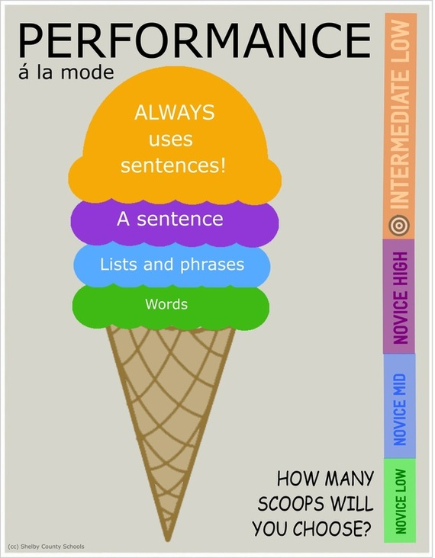
Mañana:
Portfolio interviews- talk about yourself
Create your own path to proficiency-
Bring colored pencils, crayons or markers

