Slide 1
Hoy es martes el veinticinco de agosto de dos mil quince.
White Board
El calentamiento: Write at least 3 sentences in Spanish about the picture.
Pregunta influyente: Would you tell me about yourself?
Objectivo: The Student will practice speaking with others in Spanish.
Actividades: Portfolio Interviews, conversations with classmates.
Tarea: Finish seasons description if necessary.
SPI’s: 1.1 C, D, F; 1.3 A

Slide 2
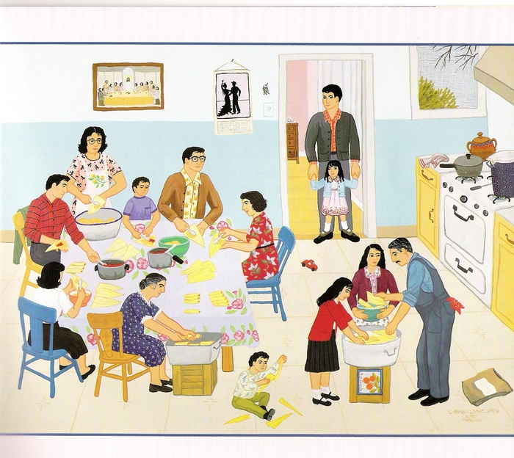
Calentamiento:
Write at least 3 sentences (in Spanish) about the picture.
Can be about anything in the picture, the people, the food, colors, clothes, what they are doing, etc.

Slide 3
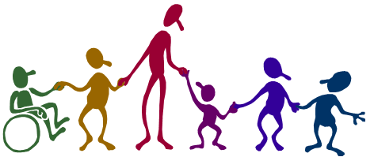
Classmate conversations
Ask 4 classmates the following questions. The conversations should be all in Spanish. You should write down their responses in Spanish. To be turned in.
Q:¿Cómo te llamas?
A: Se llama…
Q: :¿Cómo estás?
A: Él/Ella está…
Q: ¿Cuántos años tienes?
A: Él/Ella tiene… años.
Q: ¿De dónde eres?
A: Él/Ella es de…

Slide 4
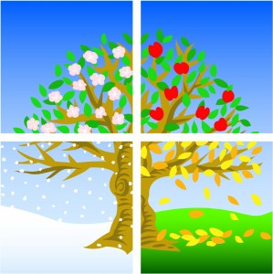
Repaso/Review
Describe the 4 seasons and list any activities you can do during that season. (All work is to be done in Spanish)

