Slide 1
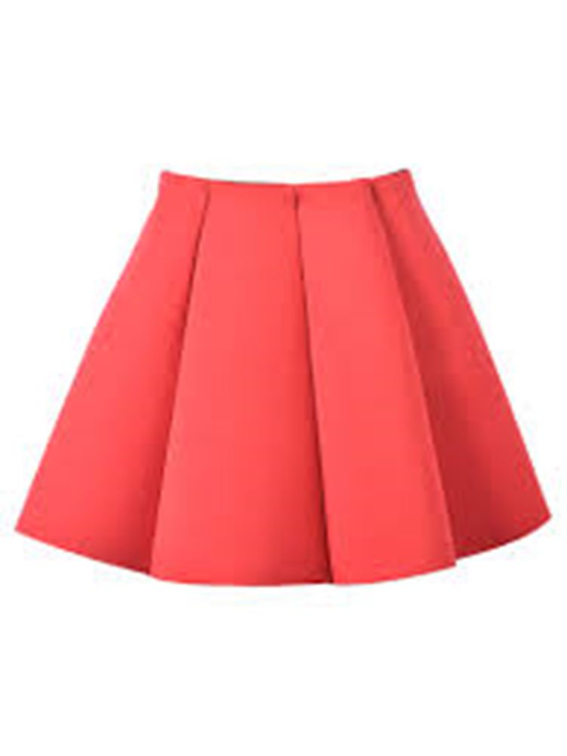
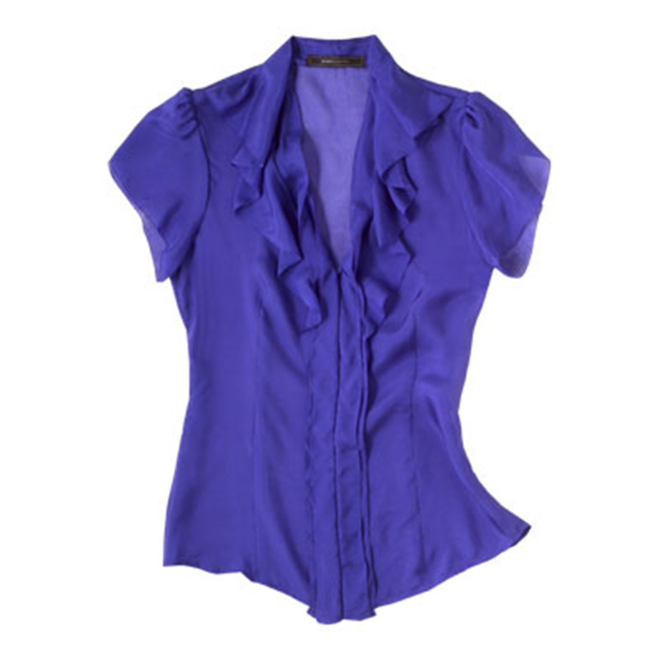
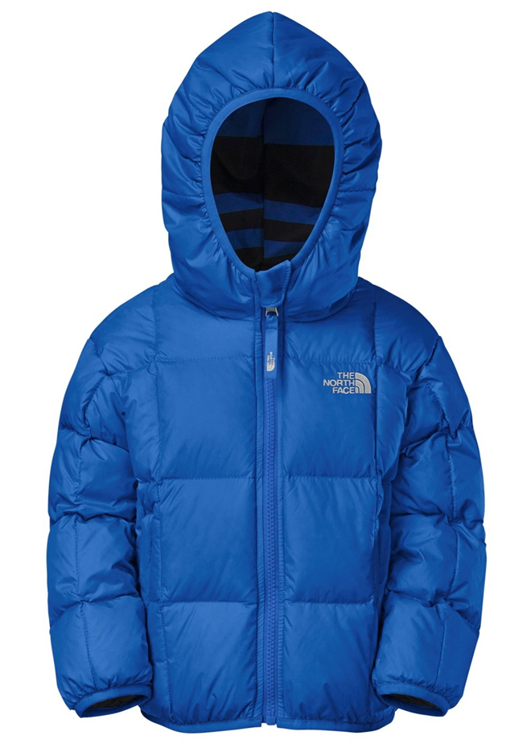
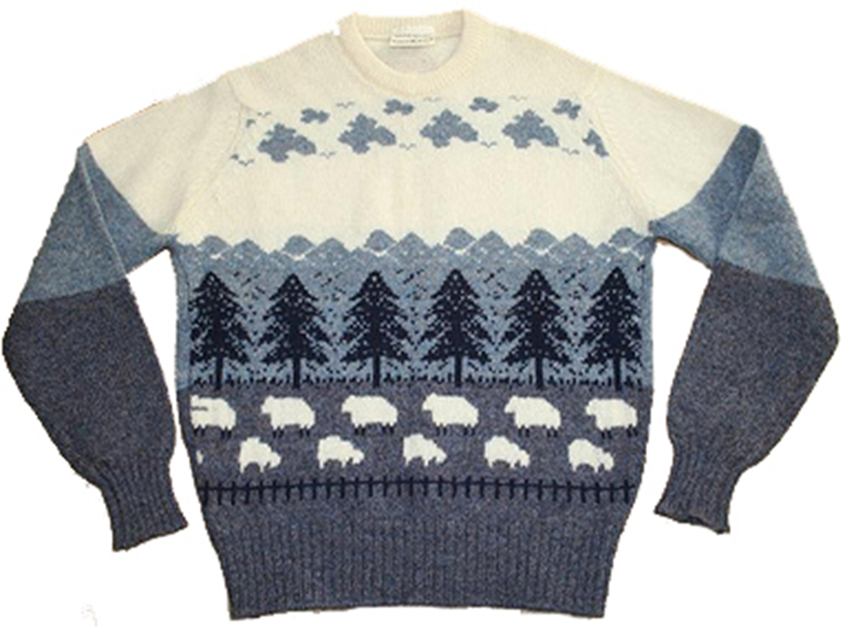
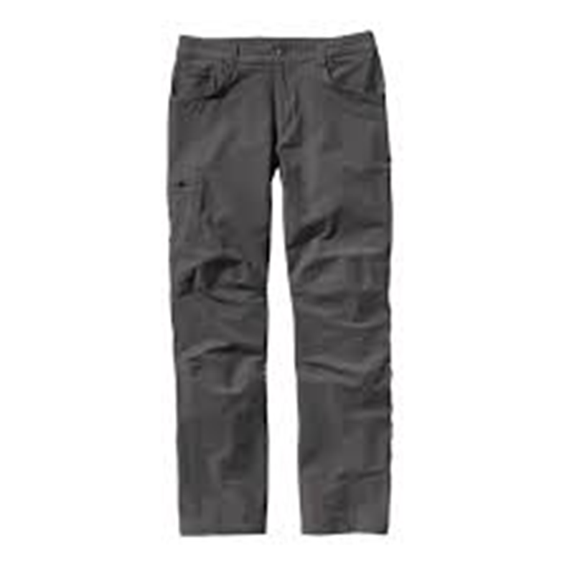
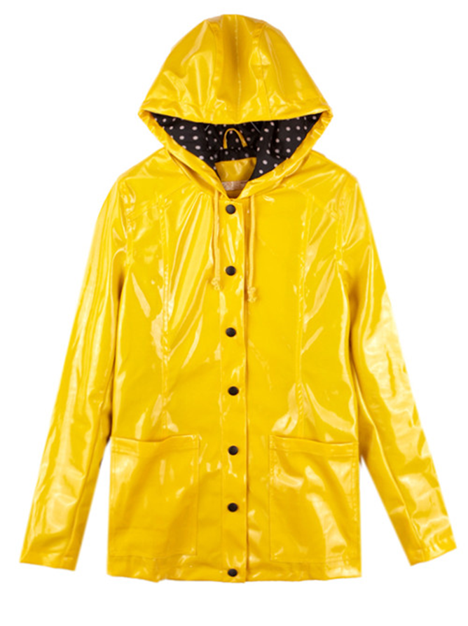
Calentamiento: Write the Spanish word that matches the picture.
1. 2. 3.
4. 5. 6.

Slide 2
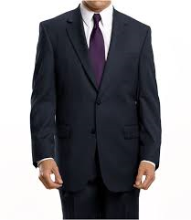
El traje

Slide 3
La corbata

Slide 4
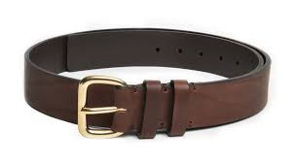
El cinturón

Slide 5
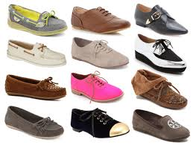
Los zapatos

Slide 6
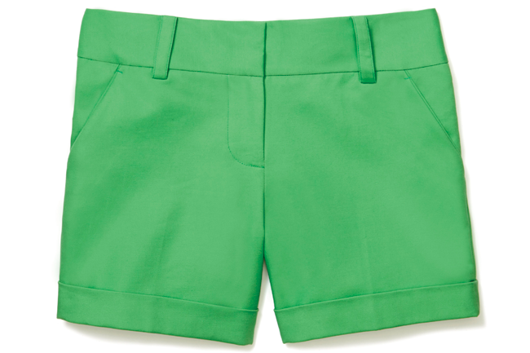
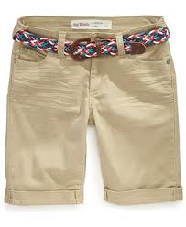
Los pantalones cortos

Slide 7
Packing List: Imagie you are going on vacation. Make a list of the clothes you will need for each location.
La playa (the beach)
Estación de esquí (ski resort)
Nueva York

Slide 8
ER/IR Verbs ER IR
Yo O O
Tú ES ES
Él/Ella/Usted E E
Nosotros/as EMOS IMOS
Vosotros/as ÉIS ÍS
Ellos/Ellas/Ustedes EN EN

Slide 9
Conjugate: put the appropriate endings on the verbs given for all pronouns.
Comer (to eat)
Beber (to drink)
Escribir (to write)
Vivir (to live)

