Slide 1
Para empezar (8/27)

Slide 2
Objetivos:
Review greetings/goodbyes and introductions
Quiz on Thursday 8/30

Slide 3
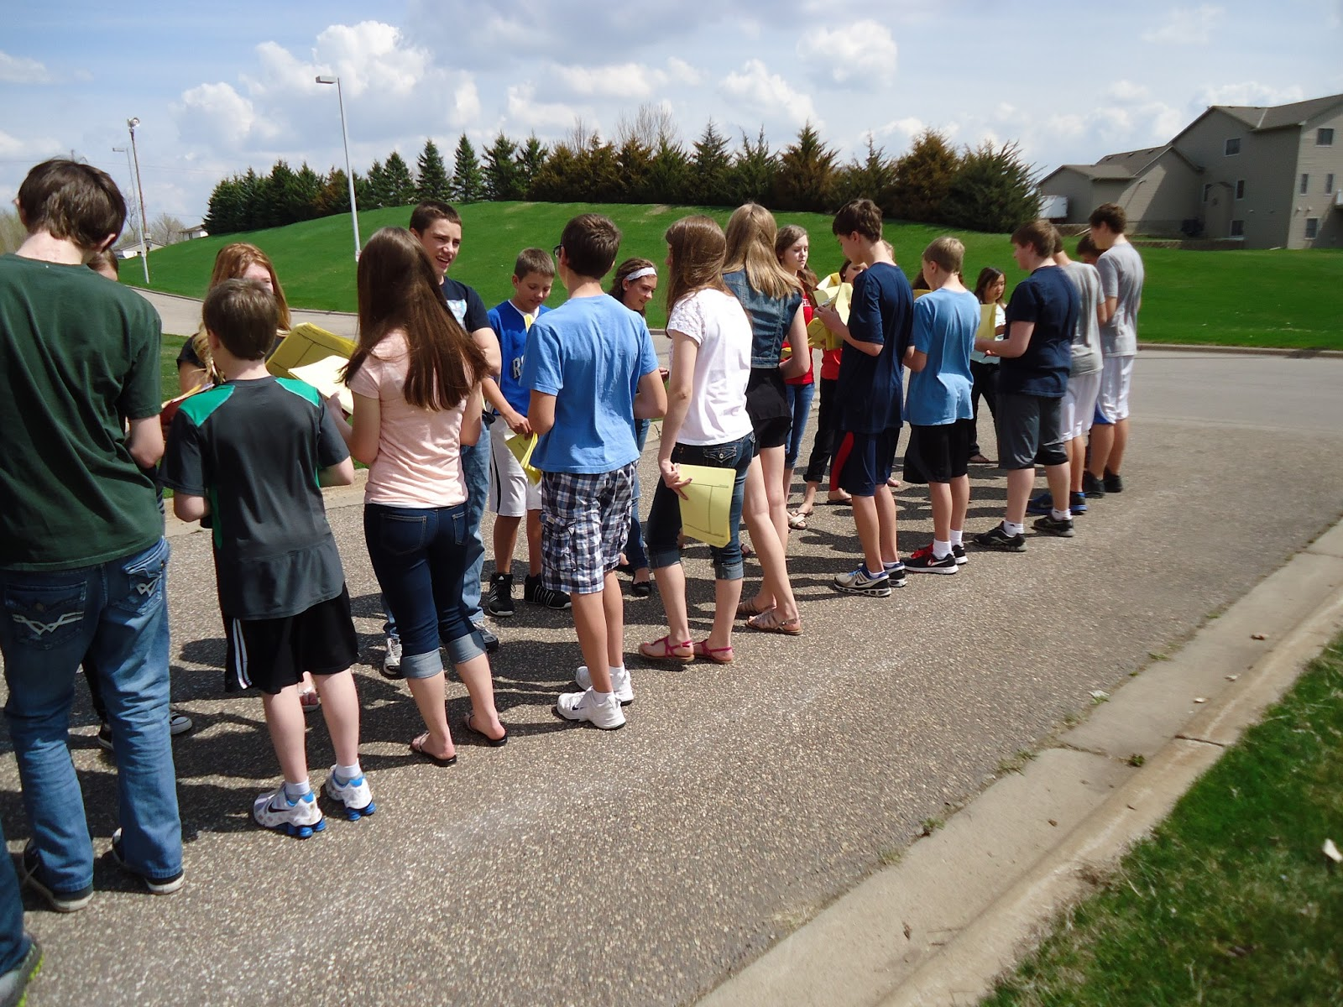
Two lines activity
What to say:
Greet each other
Ask how the other is doing
Say your names
Ask and say where each is from
Say goodbye

Slide 5
Boleto de salida
Write a dialogue between two people meeting each other for the first time. Write at least 10 sentences. Be sure to include:
Greetings
Asking and saying how each is doing
Introducing themselves to each other
Asking and saying where each is from
goodbyes

