Slide 1
Unidad 1 Lección 1

Slide 2
Para empezar (9/3)
Make a list (in English) of clubs/organizations that you participate in or activities that you do after school.

Slide 3
Objetivos
Learn and practice vocabulary about daily activities, food, and drinks.
Vocabulary quiz on Thursday 9/6.
Standards: 1.2- understand language.

Slide 4
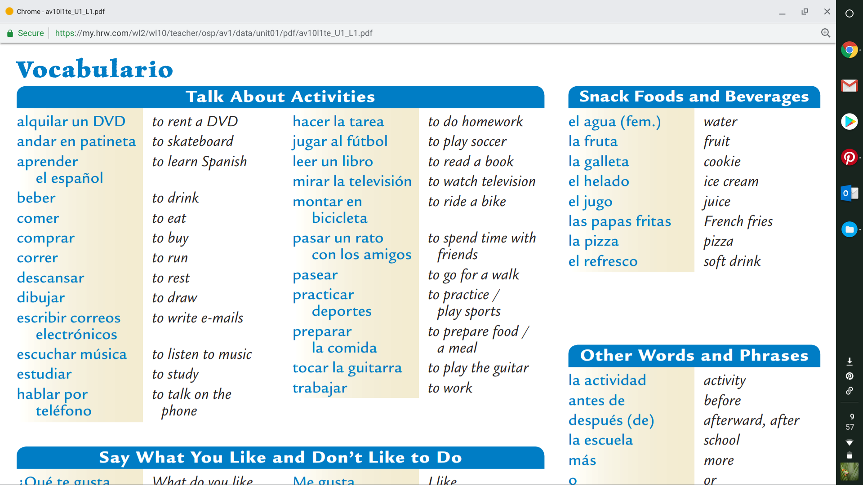
p. 51

Slide 5
Boleto de salida
Choose the letter of the answer that best completes each sentence.
1. Me gusta aprender ____.
a. la escuela b. el español c. la televisión d. el agua
2. No me gusta beber ____.
a. frutas b. galletas c. refrescos d. helado
3. A mí me gusta ____ por teléfono.
a. dibujar b. hablar c. descansar d. correr
4. También me gusta escribir ____.
a. deportes b. patinetas c. correos electrónicos d. teléfonos
5. A mí me gusta ____ en bicicleta.
a. estudiar b. montar c. mirar d. tocar

Slide 6
Para empezar (9/5)
Write the Spanish word for each picture you see.
1. 2. 3. 4. 5.

Slide 7
Objetivos:
Understand what others say about activities.
Practice talking about activities.
Quiz on Thursday 9/6 on food vocabulary + beber and comer.
Standards 1.1- engage in conversation, 1.2- understanding language, and 1.3- present information.

Slide 8
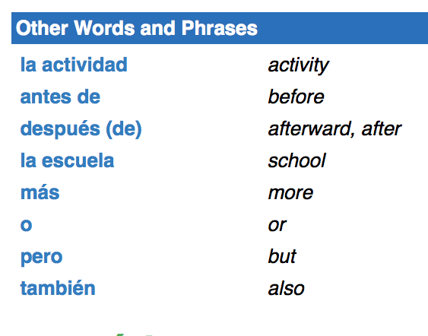

Slide 10
Objetivos:
Understand what others say about activities.
Practice talking about activities.
Standards 1.1- engage in conversation, 1.2- understanding language, and 1.3- present information.

Slide 11
Telehistoria: While watching the video, put a check under the name of the person who likes to do that activity.
Sandra | Alicia
alquilar un DVD
montar en bicicleta
andar en patineta
comer pizza
pasar un rato con amigos
trabajar dibujar hacer la tarea
jugar al fútbol
pasear hablar por teléfono
escuchar música

Slide 12
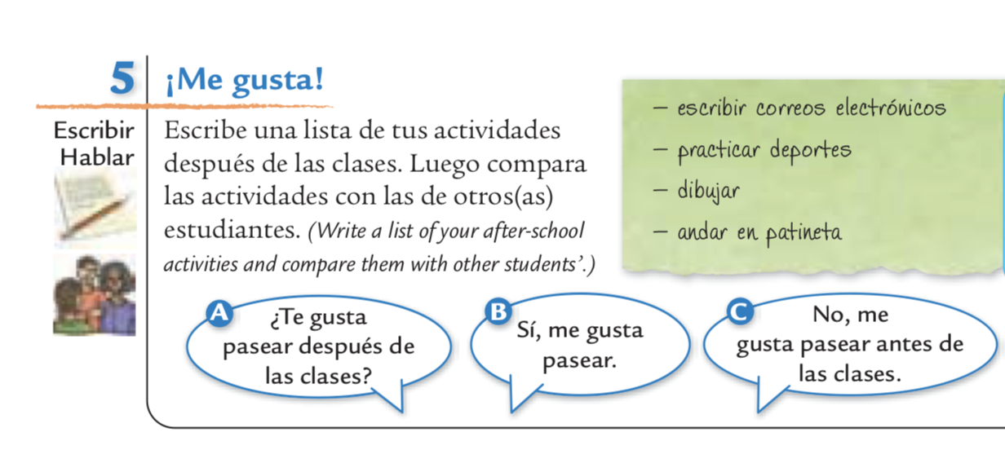

Slide 13
Boleto de salida
Answer the following question in Spanish in a complete sentence:
¿Qué te gusta hacer después de las clases?

Slide 14
Para empezar
Answer the following question(s) in English:
What is a pronoun? Give 2 examples.

Slide 15
Objetivos:
Practice using subject pronouns, pp. 37-39.
Use ser de + location to tell where someone is from.
Standards: 1.1- engage in conversation, 1.3- present information, 4.1- compare languages.

Slide 16
Subject pronouns- apuntes
Singular |  | Plural
yo | I | nosotros/nosotras | we
tú | you (familiar) | vosotros/vosotras | you (familiar)
usted | you (formal) | ustedes | you (formal)
él | he | ellos | they
ella | she | ellas | they
Nosotras, vosotras, and ellas: these are used when talking about a group of girls. If the group is all boys or a mixture of boys and girls, use nosotros, vosotros, or ellos.
Carlos y yo (Carlos and I) = nosotros
In Spanish the subject pronoun can be omitted- Yo soy de Colombia = Soy de Colombia

Slide 17
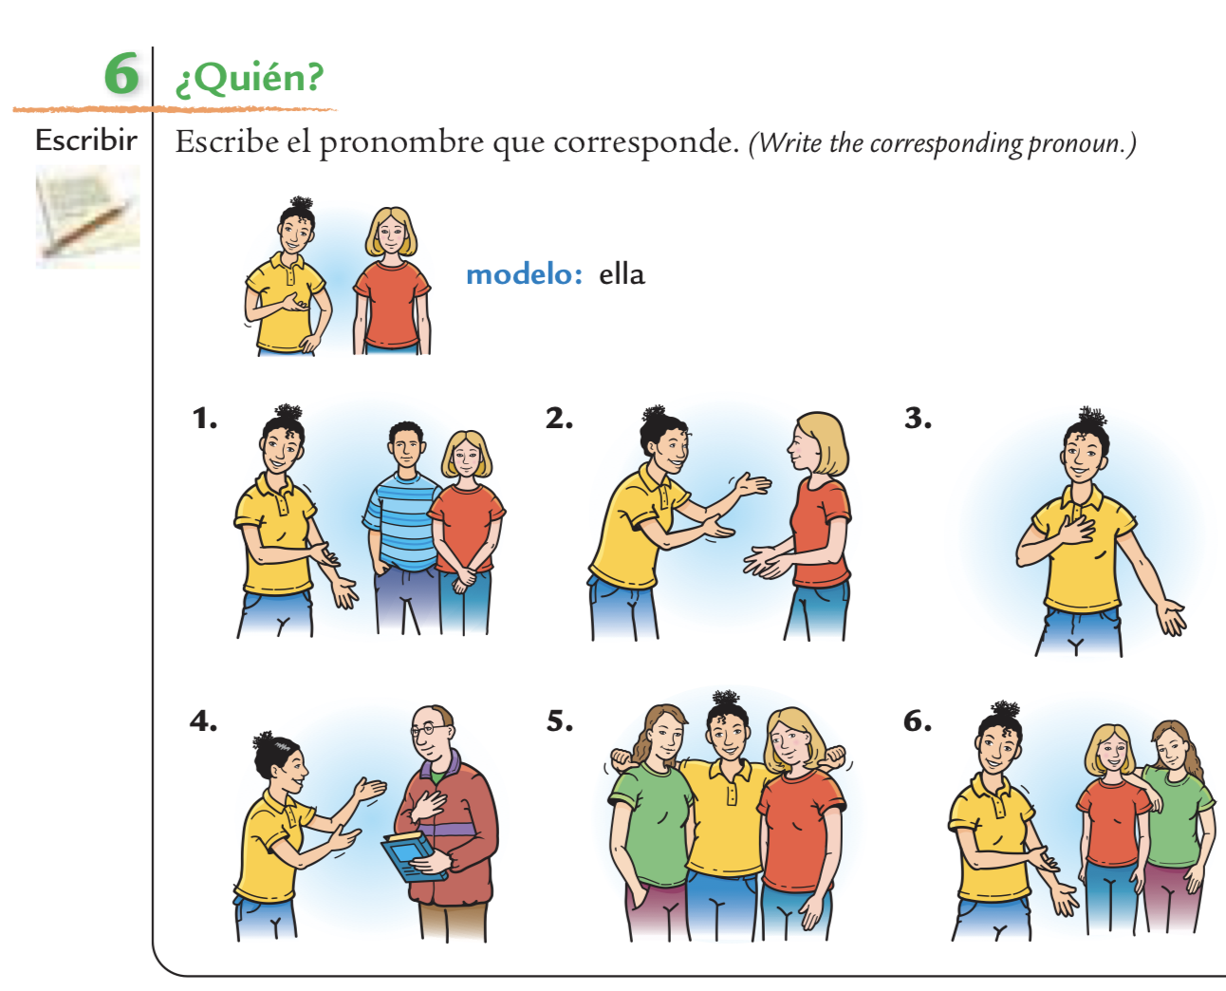
p. 38

Slide 18
Ser = to be - apuntes
Singular |  |  | Plural
yo | soy | I am | nosotros/nosotras | somos | we are
tú | eres | you are (familiar) | vosotros/vosotras | sois | you are (familiar)
usted | es | you are (formal) | ustedes | son | you are (formal)
él | es | he is | ellos | son | they are
ella | es | she is | ellas | son | they are

Slide 19
p. 38

Slide 20
p. 39

Slide 21
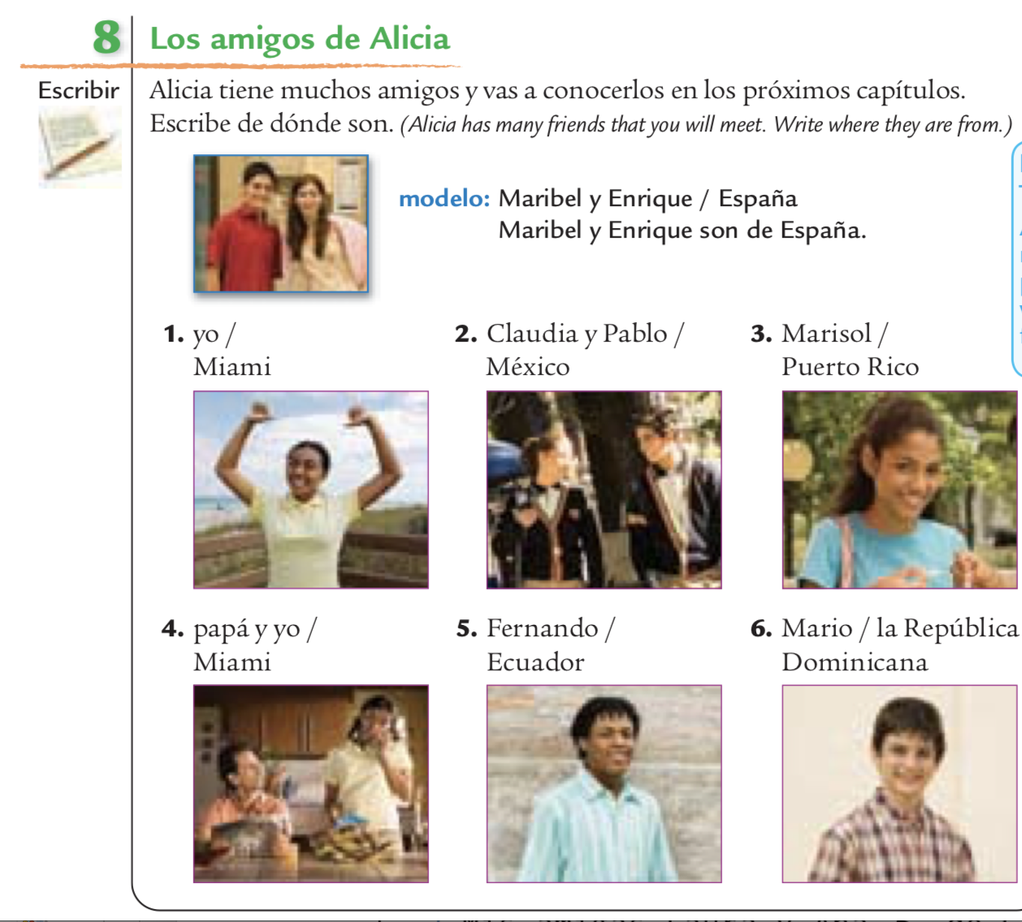
Boleto de salida
p. 39

Slide 22
Para empezar (9/10)
Complete the chart with the correct Spanish subject pronouns.
Singular |  | Plural
 | I |  | we
 | you (familiar) |  | you (familiar)
 | you (formal) |  | you (formal)
 | he |  | they
 | she |  | they

Slide 23
Prounoun Jeopardy
https://www.superteachertools.us/jeopardyx/joinjeopardylive.php?

Slide 24
Boleto de salida
Pronouns Match the letter of the pronoun to its corresponding subject.
1. Sr. Ruiz 2. Mi amigo Miguel y yo
3. Tú y Marta 4. Sandra 5. Alicia y Teresa
a. ella b. ustedes
c. ellas d. él e. nosotros

Slide 25
Para empezar (9/11)
Fill in the chart with the correct form of SER for each subject pronoun.
Singular |  |  | Plural
yo |  | I am | nosotros/nosotras |  | we are
tú |  | you are (familiar) | vosotros/vosotras |  | you are (familiar)
usted |  | you are (formal) | ustedes |  | you are (formal)
él |  | he is | ellos |  | they are
ella |  | she is | ellas |  | they are

Slide 26
P. 41, actividad 10
Quién= who

Slide 28
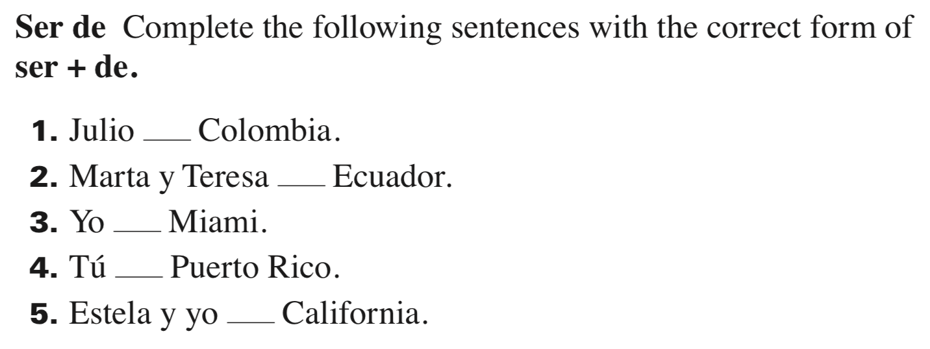
Ser practice

Slide 29
Boleto de salida
Create sentences to tell where the people are from.
Modelo: Jennifer Lopez/Nueva York Jennifer Lopez es de Nueva York
el Sr. Costas/la Florida
Alicia/Miami
Teresa y Miguel/Honduras y Cuba
Shakira y Juanes/Colombia

Slide 30
Para empezar

Slide 31
Objetivos
Present and practice gustar + infinitives.
Present personal a + noun/pronoun.
pp. 42-44
Standards: 1.1, 1.2, 1.3, 2.2, 3.1, 4.2
Vocab quiz Tuesday

Slide 32
Gustar + infinitive
In Spanish, we use the verb gustar to talk about likes and dislikes.
When talking about whether a person likes/dislikes doing a particular activity, use gustar + infinitive.
An infinitive is the initial form of a verb before it has been changed to correspond with the subject. In English, the infinitive form is to +verb (to run, to walk, etc.) In Spanish, infinitives end in –ar, -er, or –ir.

Slide 33
Subject (optional) | Pronoun (required) | Gustar
A mí | Me | gusta
A ti | Te | gusta
A usted A él A ella | Le | gusta
A nosotros | Nos | gusta
A vosotros | Os | gusta
A ustedes A ellos A ellas | Les | gusta

Slide 35
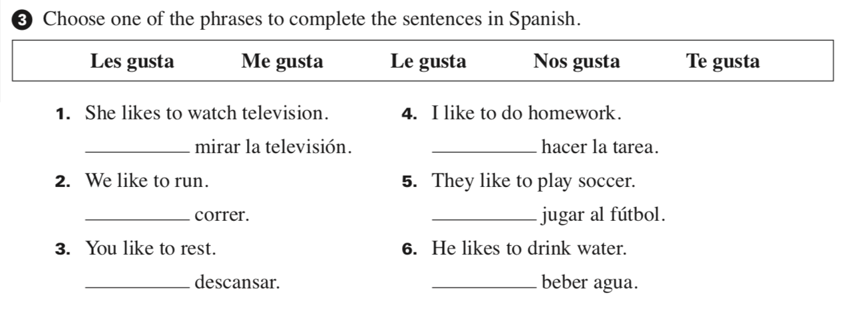
Para empezar

Slide 37
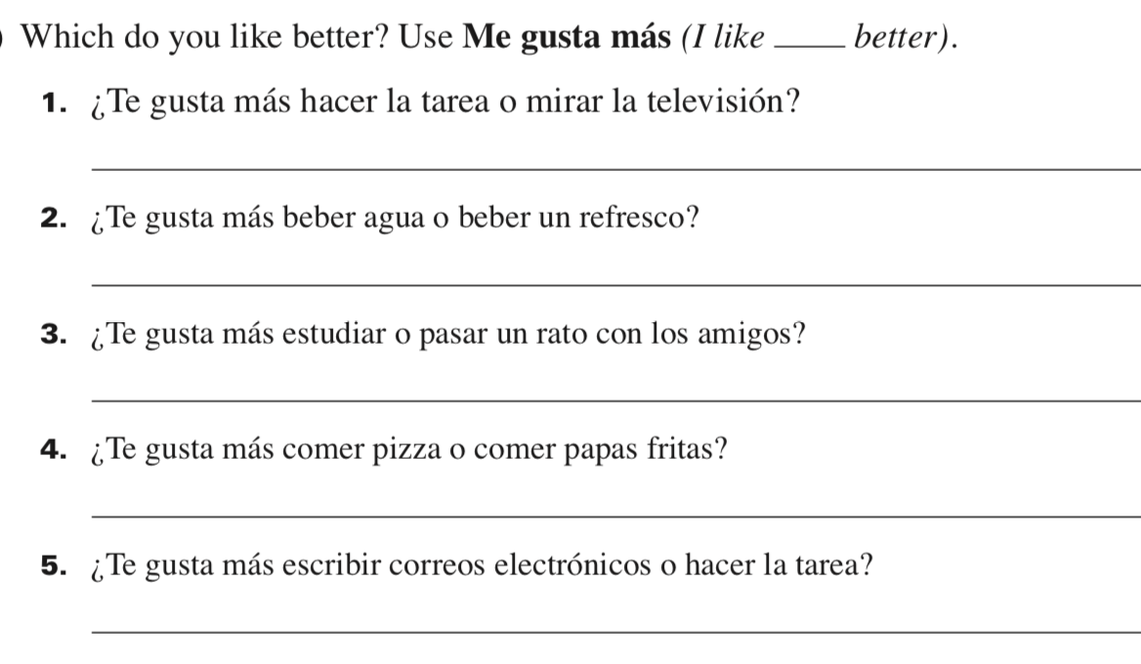

Slide 38
Boleto de salida
1. ¿Qué le gusta hacer a Jorge?
2. ¿Qué le gusta hacer a la señora Donadi?
3. ¿Qué te gusta hacer a ti?
4. ¿Qué me gusta hacer a mí? (tú)

